Slide 1
10 mins Prediction on 2016 AC Data using LSTM-RNN
Clement Lork
30 July 2017

Slide 2
Software used
Matlab for conversion into .CSV
Converted all room
Tested on 0804 and 0401
Python stack for deep learning
Enthought Canopy Python 3.5
Keras with Tensorflow backend on GPU
Spyder IDE
Links to download Python stack
https://store.enthought.com/downloads/
Pip install Keras
Pip install Spyder
https://www.tensorflow.org/install/install_windows

Slide 3
Usage Pattern for 0804
LVr
Value Count Percent
AUTO 1051240 100.00%
NULL 6 0.00%
Value Count Percent
16 0 0.00%
17 0 0.00%
18 7157 0.68%
19 16060 1.53%
20 237059 22.55%
21 135974 12.93%
22 287884 27.39%
23 275666 26.22%
24 70637 6.72%
25 20603 1.96%
26 0 0.00%
27 0 0.00%
28 3 0.00%
29 0 0.00%
30 203 0.02%
Value Count Percent
ON 588392 55.97%
OFF 462854 44.03%
Mb
Value Count Percent
AUTO 542476 52.35%
DEHUMIDIFIER 493847 47.65%
Value Count Percent
16 0 0.00%
17 0 0.00%
18 0 0.00%
19 0 0.00%
20 0 0.00%
21 0 0.00%
22 455765 43.98%
23 490275 47.31%
24 67379 6.50%
25 18165 1.75%
26 2174 0.21%
27 0 0.00%
28 2322 0.22%
29 0 0.00%
30 243 0.02%
Value Count Percent
OFF 947008 91.38%
ON 89315 8.62%
B1
Value Count Percent
COOLER 1051238 100.00%
Value Count Percent
16 42066 4.00%
17 0 0.00%
18 248 0.02%
19 0 0.00%
20 0 0.00%
21 0 0.00%
22 0 0.00%
23 0 0.00%
24 1008878 95.97%
25 46 0.00%
Value Count Percent
OFF 1051232 100.00%
ON 6 0.00%
B2
Value Count Percent
COOLER 1051733 100.00%
Value Count Percent
16 42315 4.02%
17 0 0.00%
18 0 0.00%
19 0 0.00%
20 0 0.00%
21 0 0.00%
22 0 0.00%
23 0 0.00%
24 8 0.00%
25 40 0.00%
26 0 0.00%
27 0 0.00%
28 0 0.00%
29 0 0.00%
30 1009370 95.97%
Value Count Percent
OFF 1051728 100.00%
ON 5 0.00%
0804 don’t use other bedrooms much

Slide 4
Usage Pattern for 0401
LVr
Value Count Percent
DEHUMIDIFIER 833150 79.18%
COOLER 25032 2.38%
NULL 322 0.03%
AUTO 193653 18.41%
Value Count Percent
16 0 0.00%
17 0 0.00%
18 0 0.00%
19 0 0.00%
20 0 0.00%
21 0 0.00%
22 174 0.02%
23 1512 0.14%
24 22698 2.16%
25 9409 0.89%
26 39783 3.78%
27 224151 21.30%
28 737307 70.08%
29 16745 1.59%
30 378 0.04%
Value Count Percent
OFF 818096 77.75%
ON 234061 22.25%
Mb
Value Count Percent
DEHUMIDIFIER 965205 91.92%
NULL 319 0.03%
AUTO 41650 3.97%
COOLER 42830 4.08%
Value Count Percent
16 24 0.00%
17 0 0.00%
18 0 0.00%
19 0 0.00%
20 460 0.04%
21 2 0.00%
22 603 0.06%
23 8 0.00%
24 1 0.00%
25 22117 2.11%
26 24352 2.32%
27 131651 12.54%
28 687614 65.49%
29 177846 16.94%
30 5326 0.51%
Value Count Percent
OFF 415989 39.62%
ON 634015 60.38%
B1
Value Count Percent
COOLER 101243 9.61%
DEHUMIDIFIER 751482 71.30%
NULL 274 0.03%
AUTO 201000 19.07%
Value Count Percent
16 0 0.00%
17 0 0.00%
18 100 0.01%
19 0 0.00%
20 0 0.00%
21 0 0.00%
22 9483 0.90%
23 49990 4.74%
24 422 0.04%
25 35680 3.39%
26 51543 4.89%
27 236828 22.47%
28 576434 54.69%
29 90788 8.61%
30 2731 0.26%
Value Count Percent
OFF 901510 85.53%
ON 152489 14.47%
This room uses all 4 different modes

Slide 5
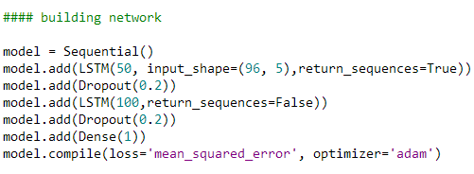
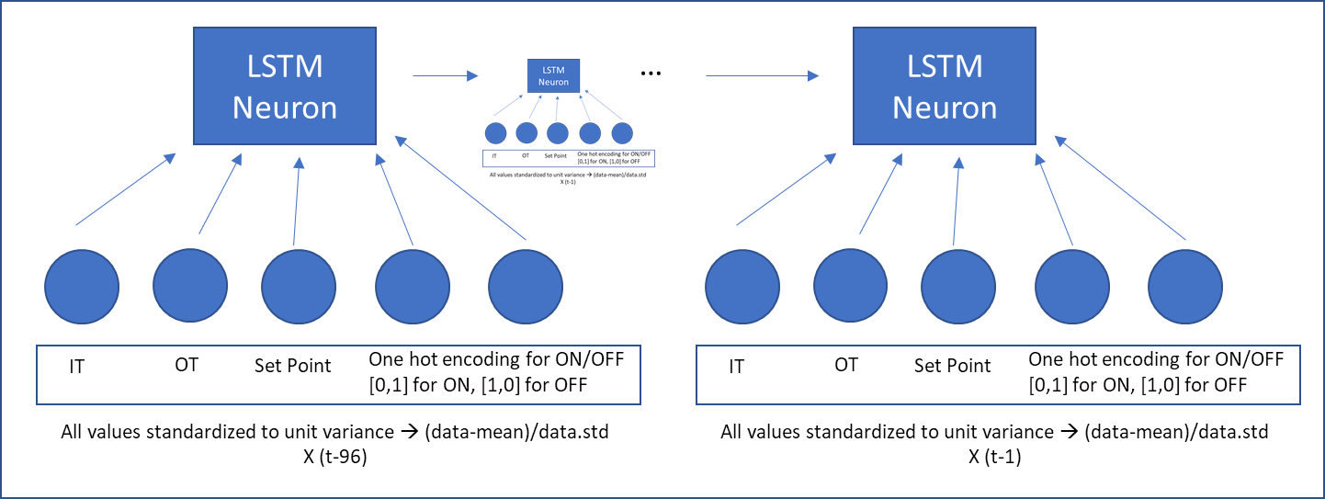
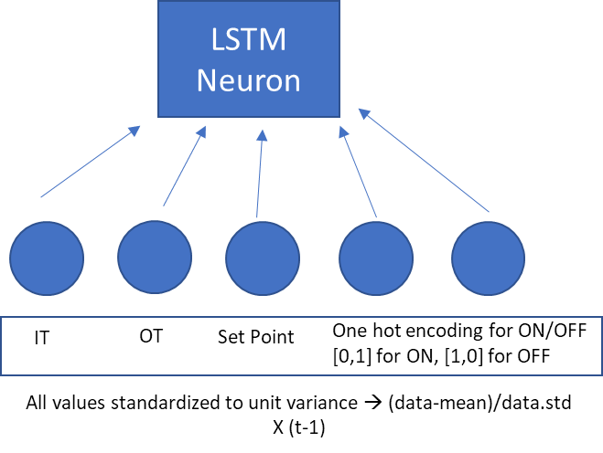
LSTM used for 0804 LVr
Single neuron with
Linear activation function in (3rd) final layer
LSTM
Neuron
X100 of such neurons in 2nd layer, 20% dropout
Output
…
Linear
Neuron
LSTM
Neuron
…
LSTM Neuron
Unpacked LSTM for 1st layer
LSTM Neuron
…
X50 of such neurons in 1st layer,
20% dropout
The unpack of the 2nd layer will be the same as that of the first layer, although with 50 inputs
Inputs for multi-split bedrooms will increase
IT
OT
Set Point
One hot encoding for ON/OFF
[0,1] for ON, [1,0] for OFF
IT
OT
Set Point
One hot encoding for ON/OFF
[0,1] for ON, [1,0] for OFF
All values standardized to unit variance → (data-mean)/data.std
X (t-96)
All values standardized to unit variance → (data-mean)/data.std
X (t-1)

Slide 6
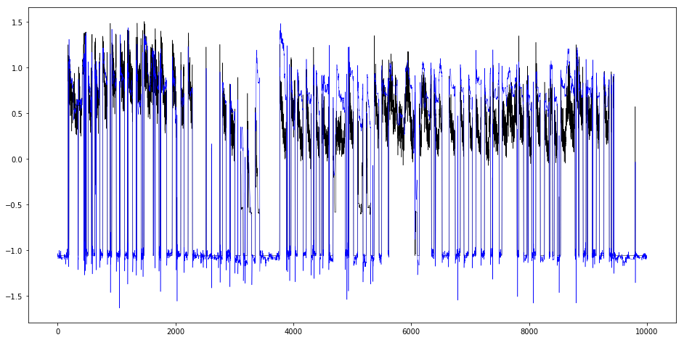
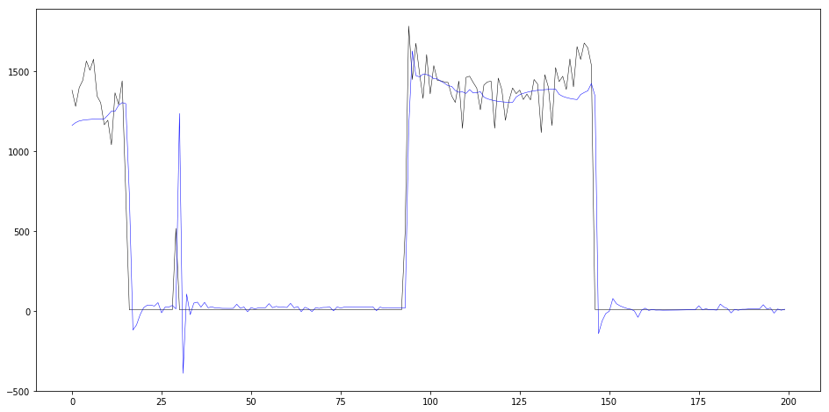
Results for 0804 LVr
Overall (1:10000)
Trained on
X = [ IT, OT, Setpoint, [ON/OFF] ](t-1 to t-96) → 3 normal + 2x 1hot vectors
Y = Power (t)
1 timestep→ 10 min
RMSE = 289.781083574
MAPE = 2.60436196686
Seems like the LSTM is able to capture the general trend but again is lagging
→Need a room thermal model+ AC model+ Behaviour model
Sometimes LSTM outputs <0 or fluctuates around the low values → gets penalized heavily by MAPE
If fluctuations are removed → predicted<100=7
MAPE = 1.09212201702
Overall (2000:2200)
Black actual
Blue predicted

Slide 7
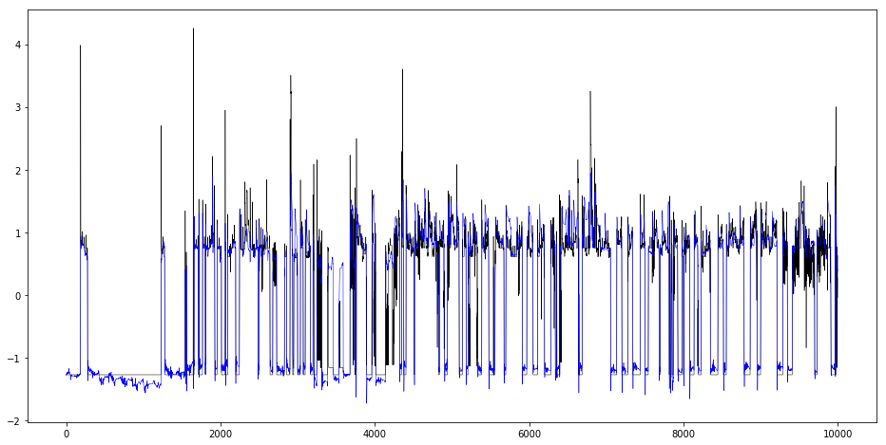
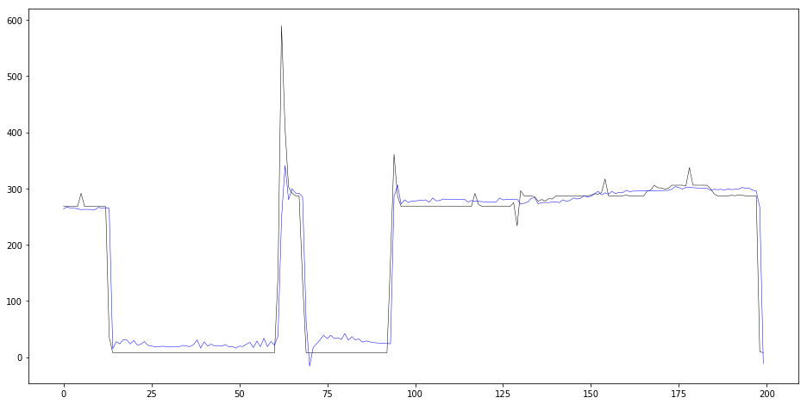
Results for 0401 Bedr
Overall plot (1:10000)
Blue- Predicted
Black- Actual
Trained on
X = [ IT_B1, Setpoint_B1, IT_Mb, Setpoint_Mb, OT,
[ON/OFF]_B1, [ON/OFF]_Mb ,[3 modes]_B1 ],[3 modes]_Mb(t-1 to t-96) → 5 normal + 10x1hot vectors
Y = Power (t)
1 timestep→ 10 min
RMSE = 56.750771871
MAPE = 1.04924480112
Still problem with lagging
→Need a room thermal model+ AC model+ Behaviour model
Sometimes LSTM outputs <0 or fluctuates around the low values → gets penalized heavily by MAPE
If fluctuations are removed → predicted<100=7
MAPE = 0.461951918621
Zoomed plot (2000:2200)

Slide 8
Future Directions
LSTM training is quite fast ~10mins can shorten with tweaks to architecture
Try to model room dynamics with RNN + AC model with RNN
Do stepwise calculations
Point of using LSTM/CNN is do away with the feature selection process like the Smartgreens paper
Try out other probabilistic neural networks too

